Slide 1
Enrolment in the
1st Year of
Doctoral (PhD) Study Programmes
Department for Science
Department for Science Charles University – First Faculty of Medicine
Oddělení pro vědeckou činnost 1. LF UK

Slide 2
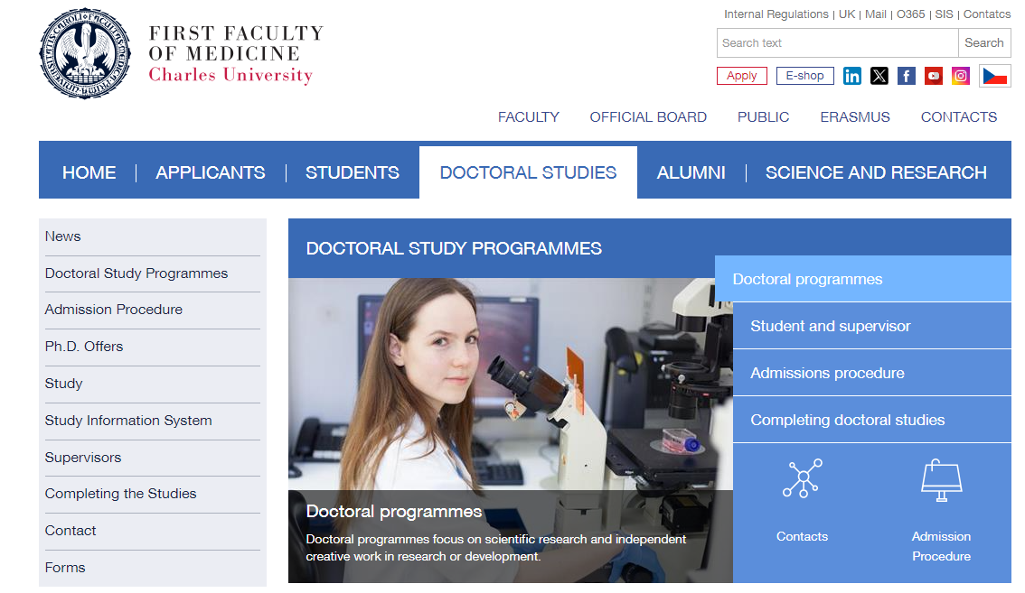
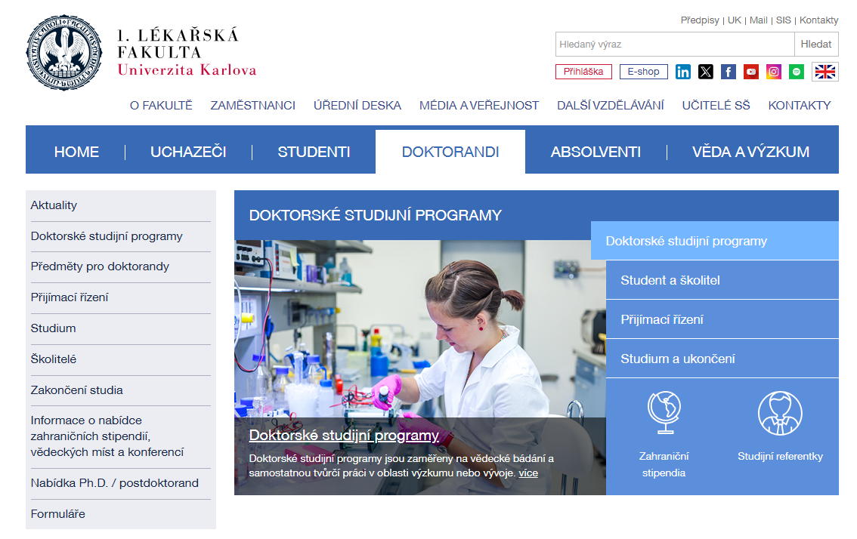
Information about studies in doctoral (PhD) study programmes at the First Faculty of Medicine can be found at:
ENG:
https://en.lf1.cuni.cz/doctoral-studies-
CZ:
https://www.lf1.cuni.cz/doktorandi
Department for Science Charles University – First Faculty of Medicine
Oddělení pro vědeckou činnost 1. LF UK

Slide 3
Doctoral students
An applicant becomes a student by the day of enrolment.
The standard duration of studies in a doctoral study programme is four years.
The maximum duration of studies in a doctoral study programme is eight years.
Time of suspension of studies counts in the total duration of studies, apart from the parent leave and serious health reasons.
Department for Science Charles University – First Faculty of Medicine
Oddělení pro vědeckou činnost 1. LF UK

Slide 4
Doctoral students
Study in doctoral study programmes at Charles University is carried out in full-time or part-time/combined form.
Both forms are completely equivalent in terms of content, length and meaning.
Differences between full-time and combined forms of doctoral study programmes can be found here.
Department for Science Charles University – First Faculty of Medicine
Oddělení pro vědeckou činnost 1. LF UK

Slide 5
First steps when beginning the studies
After enrolment, visit a Card Service Centre of Charles University (with a confirmation of study and your ID) to get the access to Student Information System (SIS) as a doctoral student of the 1st Faculty of Medicine.
After the beginning of the academic year 2025/2026 (1.10.2025) insert your Individual Study Plan into SIS, the manual will be e-mailed to you.
Department for Science Charles University – First Faculty of Medicine
Oddělení pro vědeckou činnost 1. LF UK

Slide 6




Student Information System (SIS)
SIS serves for management of:
personal details (e-mail, telephone, bank account, address);
Individual study plan (ISP) and its annual evaluation;
record of the courses passed;
record of study placements
Department for Science Charles University – First Faculty of Medicine
Oddělení pro vědeckou činnost 1. LF UK

Slide 7

Individual Study Plan (ISP)
ISP corresponds by its extent to accreditation of the specific doctoral study programme.
ISP is compiled for the standard duration of studies (4 years).
ISP contains the topic of dissertation thesis, planned terms of stages of research work, obligatory subjects (English language incl.), interships (training), publication, planned completion of colloquium on the dissertation topic and defence of the dissertation thesis.
Department for Science Charles University – First Faculty of Medicine
Oddělení pro vědeckou činnost 1. LF UK

Slide 8
Individual Study Plan
The ISP will be prepared by the student in SIS in cooperation with his/her supervisor within 2 months from the start of the study, the manual for setting up the ISP will be sent by email
The approved ISP is the basis for the annual evaluation
Failure to complete the ISP will lead to termination of studies
Writing of the dissertation topic by the supervisor, creation of the ISP by the student | by 31. 10. 2025
Submission of the ISP by the supervisor to the Subject Area board | by 15. 11. 2025
Approval of the ISP by the Subject Area Board | by 30. 11. 2025
Department for Science Charles University – First Faculty of Medicine
Oddělení pro vědeckou činnost 1. LF UK

Slide 9
Individual Study Plan - Courses
In the first year of your studies, courses will be automatically registered for you according to the approved Individual Study Plan (ISP).
In subsequent years, you will register for courses electronically by yourself.
Exam results are entered directly into the SIS by the instructors (paper index books are no longer issued as of this year).
English language exam – if you are substituting the exam with a certificate, please send or hand over a copy of your certificate to your study officer (they will arrange the further process for recognizing the certificate as the English language course).
Department for Science Charles University – First Faculty of Medicine
Oddělení pro vědeckou činnost 1. LF UK

Slide 10
Scholarships
All scholarships are governed by:
  Act No. 111/1998 Coll. (the Higher Education Act)
  Scholarship and Bursary Rules
According to the Scholarship Rules, a student may be granted a scholarship, for example:
  For research, development, and innovation activities
  In cases worthy of special consideration
  To support study abroad
  Doctoral scholarship
Department for Science Charles University – First Faculty of Medicine
Oddělení pro vědeckou činnost 1. LF UK

Slide 11
Practical information - changes
For any changes related to the studies, such as:
changes of Supervising/Consulting Tutors, alterations in the title of the dissertation thesis, recognition of exams and credits, etc., you have to submit a signed General application (available at the website).
With the General application, signed by you and your Supervisor, see your Registrar at the Dept. for Science. The application will be forwarded to the respective Chairperson of the Subject Area Board.
Approved or not, the application is forwarded to the Dean for comments.
Department for Science Charles University – First Faculty of Medicine
Oddělení pro vědeckou činnost 1. LF UK

Slide 12
Study registrars by study programmes
Mgr. Eva Charouzdová
Biochemistry and Pathobiochemistry; Experimental Surgery; Experimental and Clinical Oncology; Experimental intensive medicine;
Human Physiology and Pathophysiology; Cardiovascular Science; Microbiology; Imaging Methods in Medicine
Karolína Soukupová
Addiction: Specialization in Health Care; Bioethics;
Biomedical Informatics; Cell Biology and Pathology; Dermatovenerology; Developmental and Cell Biology; History of Medicine; Immunology; Medical Biophysics; Medical Psychology and Psychopathology; Molecular and Cellular Biology Genetics and Virology; Pharmacology and Toxicology; Neurosciences; Nutritional and Metabolic Sciences; Parasitology; Preventive Medicine and Epidemiology,
Department for Science Charles University – First Faculty of Medicine
Oddělení pro vědeckou činnost 1. LF UK

Slide 13

Contacts
Registrars for doctoral study programmes:
Mgr. Bc. Eva Charouzdová | tel.: 224 96 4286 | eva.charouzdova@lf1.cuni.cz
Karolína Soukupová | tel.: 224 96 4330 | karolina.soukupova@lf1.cuni.cz
Jarmila Kopecká | tel.: 224 96 4428 | jarmila.kopecka@lf1.cuni.cz
Hana Kameníková | tel.: 224 96 4315 | hana.kamenikova@lf1.cuni.cz
Head of the department:
Bc. Bohdana Frantíková | tel.: 224 96 4187 | bohdana.frantikova@lf1.cuni.cz
Department for Science Charles University – First Faculty of Medicine
Doctoral study programmes
Oddělení pro vědeckou činnost 1. LF UK

Slide 14
Office hours
1. 9. 2025 – 30. 6. 2026
Monday | 8 am – 12:30 pm
Tuesday and Thursday | 12:30 pm – 3:30 pm
Wednesday and Friday | Closed
A visit outside office hours is possible by prior telephone agreement with your study assistant.
Department for Science Charles University – First Faculty of Medicine
Oddělení pro vědeckou činnost 1. LF UK

Slide 15
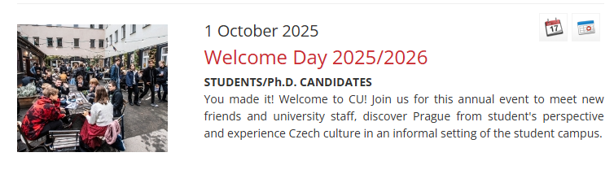
Invitation
Welcome Day 2025/2026
1. October 2025 16:00 – 22:00
Kampus Hybernská
Department for Science Charles University – First Faculty of Medicine
Oddělení pro vědeckou činnost 1. LF UK
Notes:
Pořádá se vždy zkraje zimního semestru a má za cíl obeznámit nové studující s jejich studijními povinnostmi, právy, možnostmi a nabídkami, které jsou doktorandům a doktorandkám ušity na míru. Dalším cílem je sdružování všech studujících na doktorských programech UK a snaha vytvářet mezi nimi hlubší sociální vazby napříč všemi fakultami. Témata: Představení doktorského studia na UK, Podpora v rámci doktorského studia, Možnosti financování studia a výzkumu, žádosti o granty, Centrum resilience UK: Podpora při zátěžových a krizových situacích, Doktorské studium v praxi

Slide 16

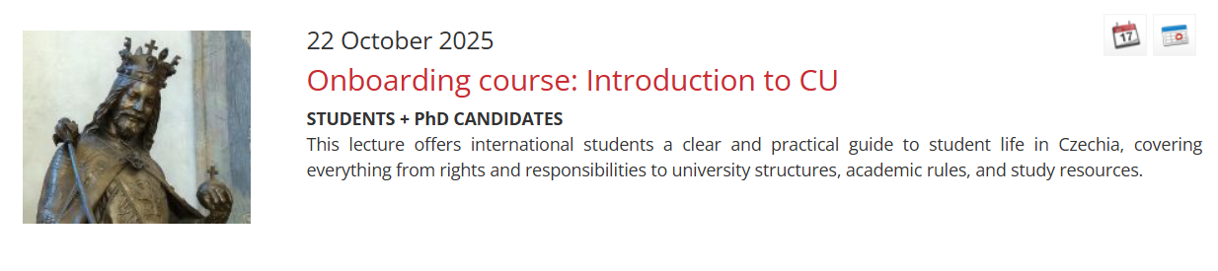
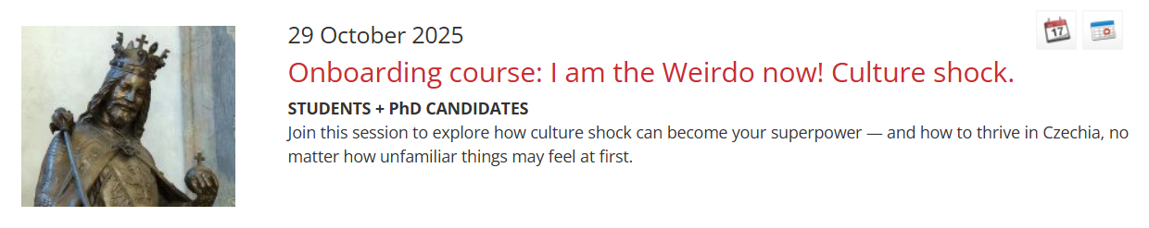
Calendar - Charles University
Department for Science Charles University – First Faculty of Medicine
Oddělení pro vědeckou činnost 1. LF UK

Slide 17
The studies are subject to
Higher Education Act
Constitution of Charles University
Code of Study and Examination of Charles University
Rector’s Order 5/2020 - Manual for doctoral studies
Internal regulations of the First Faculty of Medicine
According to Article 36(1) of Higher Education Act, internal regulations of the university are subject to registration by the Ministry. Therefore, the only legally binding regulations are those in Czech which have been registered by the Ministry and these translations are for informative purpose only. https://cuni.cz/UKEN-121.html
Department for Science Charles University – First Faculty of Medicine
Oddělení pro vědeckou činnost 1. LF UK

